Slide 1
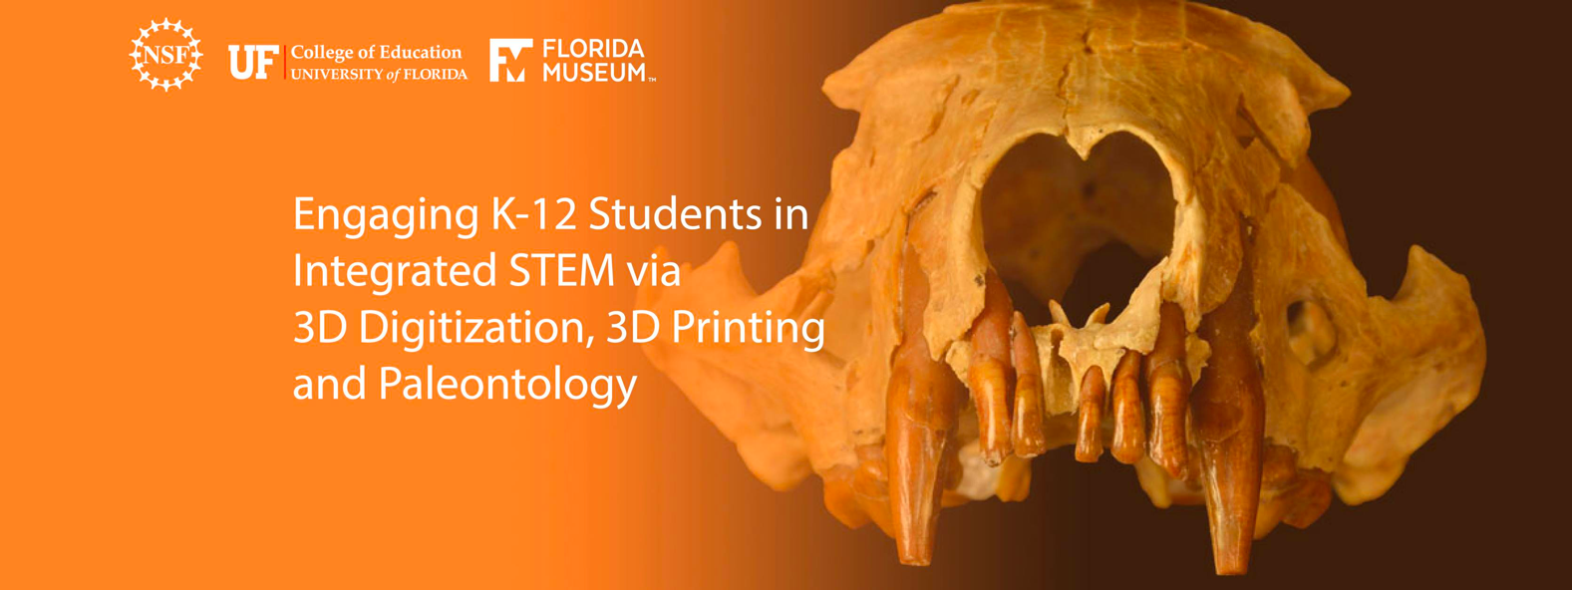
iDigFossils

Slide 2
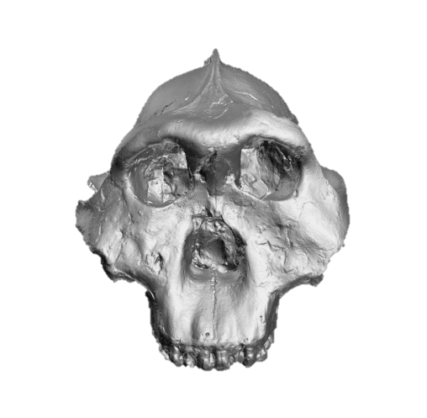
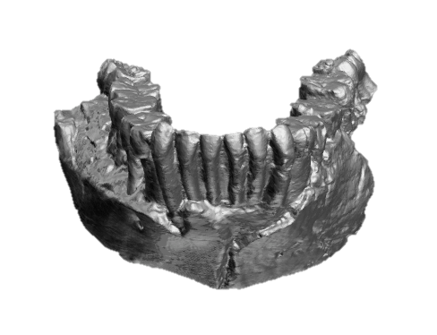
A Comparison of Hominins Using Fossils such as Teeth and Skulls
Molly Selba, Michael Ziegler,
Claudia Grant, and Rudy Simpson

Slide 3
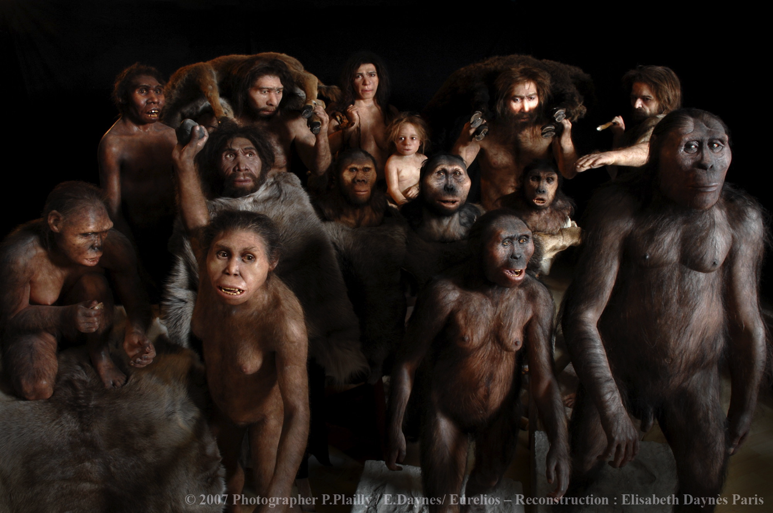

Slide 4
Why teach Human Evolution?
Through the study of evolution, students can learn about ecology, the environment, paleoanthropology, biology, and what makes us human.
It is often easier for students to see and understand evolution in terms of other animals, but they find it hard to conceptualize it in the context of us as humans. By looking at hominin mandibles, students can better understand how we ourselves are the products of evolution just as much as any other organism.

Slide 5
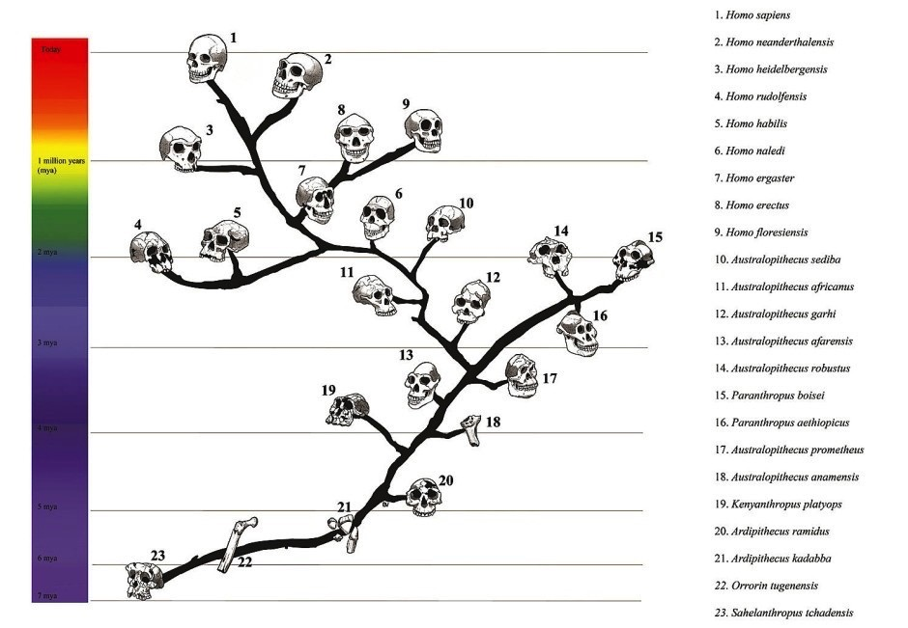

Slide 6
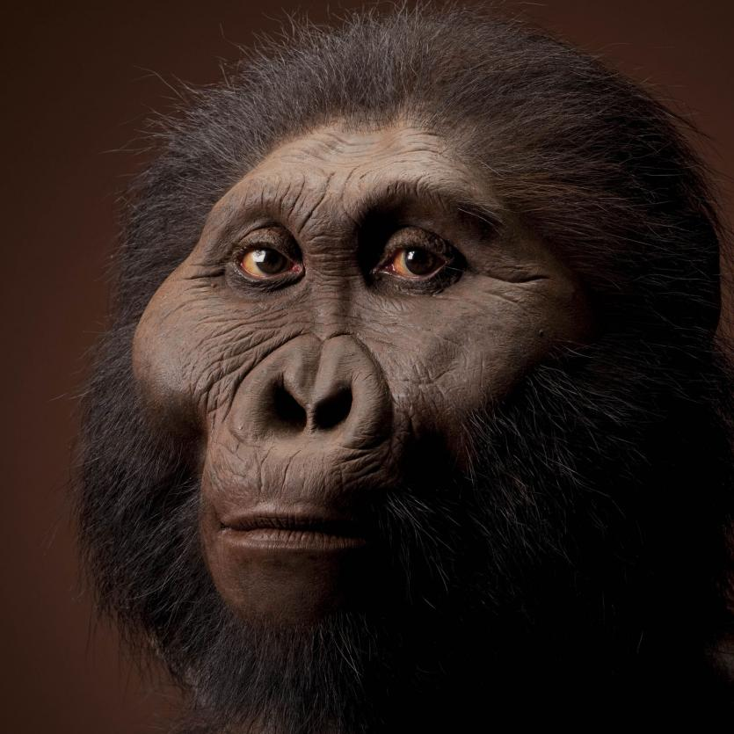
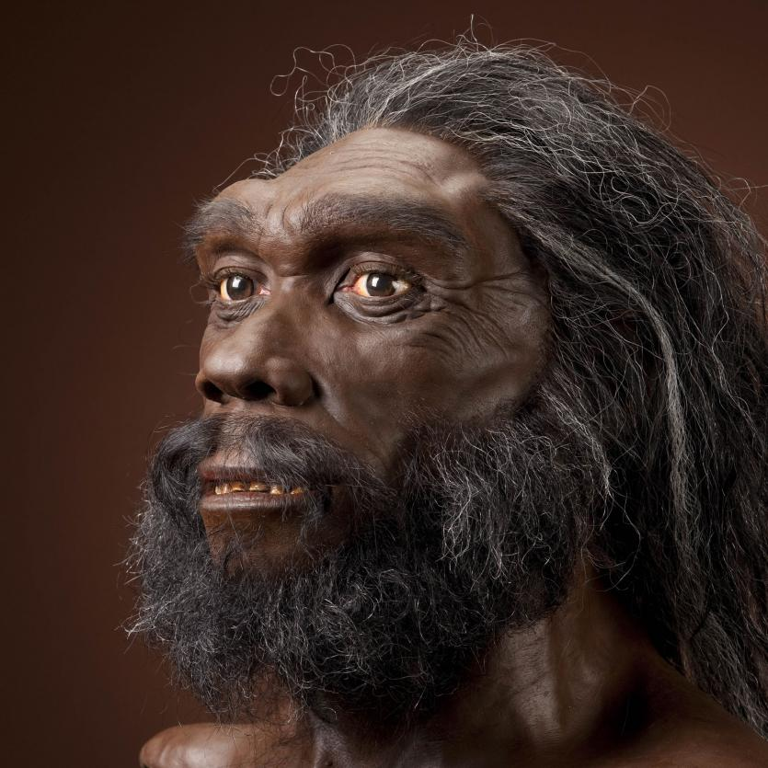
Paranthropus boisei
2.4-1.4 Ma
Lived in Eastern and Southern Africa
Homo heidelbergensis
700 -200 ka
Lived in Eastern and Southern Africa, Europe, and Asia (?)
Reconstructions by John Gurche

Slide 7
A Comparison of Hominins Using Fossils such as Teeth and Skulls
Grade Level: Middle School
Time Frame: One 50-minute class period
Driving Questions: How did geographic location and available resources vary between different hominins? How did different hominins adapt to these surroundings?
Learning Goals:
  Collecting data in order to compare and contrast tooth size and learn about tooth morphology
  Relating shape and size of teeth with geographic location and available diet

Slide 8
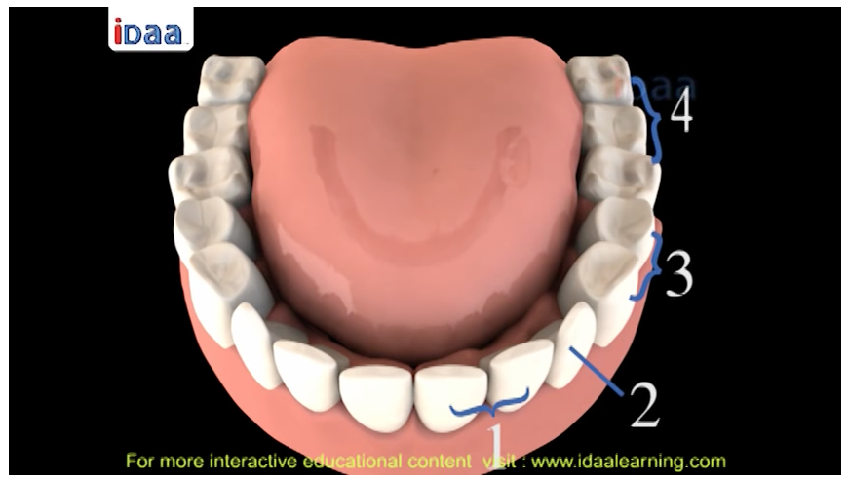
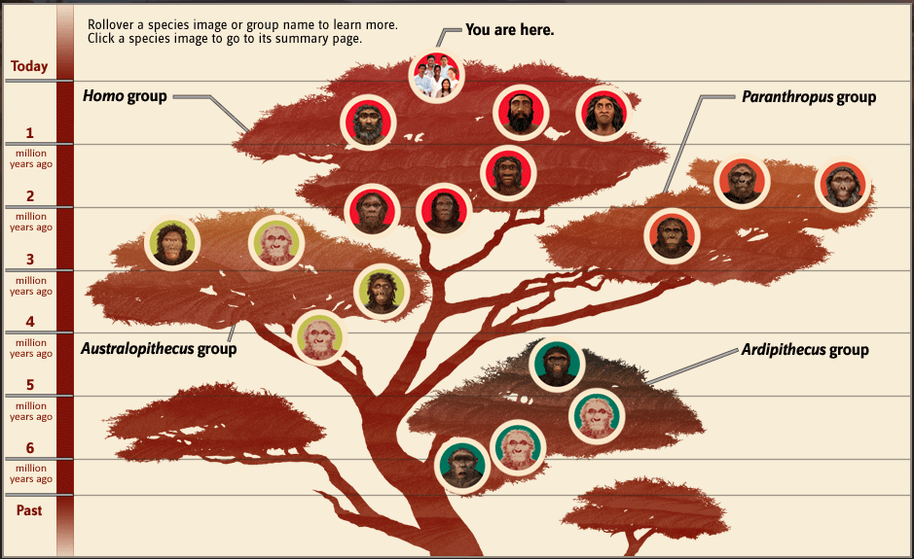
Anchoring Events
There are two different anchoring events that we suggest presenting to the students before starting this activity.
Using the 3D printed models, find information you think will help you identify similarities and differences between the two hominin mandibles and how they might relate to the tree on this website: http://humanorigins.si.edu/evidence/human-family-tree
Watch this YouTube video and start thinking about the different tooth types and discuss their function: https://www.youtube.com/watch?v=co4kSPqRi9o

Slide 9

Curriculum Connections
Biological Evolution: Unity and Diversity
Apply scientific ideas to
construct an explanation
for the anatomical
similarities and differences
among modern organisms
and between modern and
fossil organisms to infer
evolutionary relationships.
MS-LS4-2

Slide 10
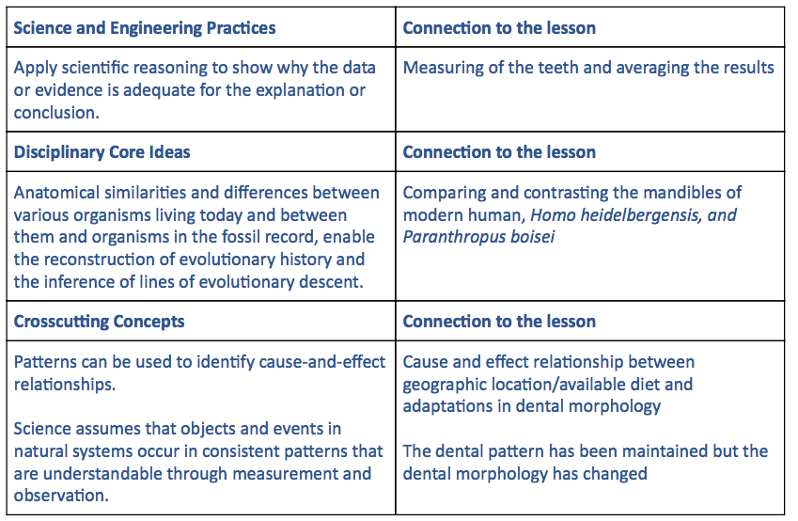

Slide 11
Lab Activity
Students obtain two 3D printed hominin mandibles– one belonging to Homo heidelbergensis and one belonging to Paranthropus boisei.
The activity is structured in two ways. In one lab the species belonging to each mandible is known and the objective is to determine each of their diets. In the other lab the students must identify which species the mandibles belong to based off of their diet.
Students learn about the types of teeth in the human mouth as well as the their function and number.
Students also learn to take dental measurements, average the measurements with those of their peers, and think critically about their results.

Slide 12
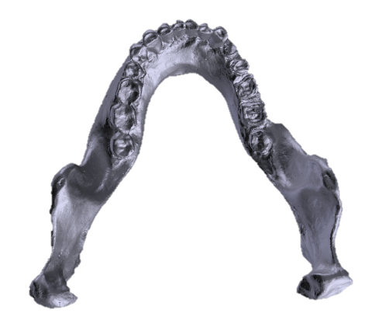
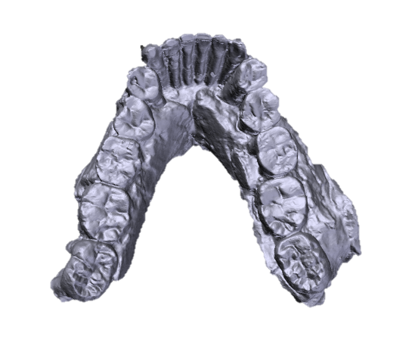
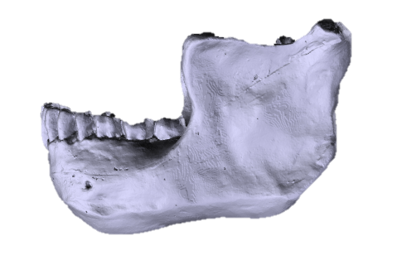
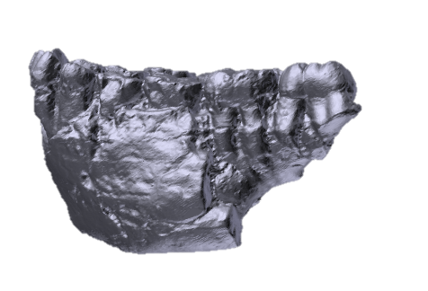

Slide 13
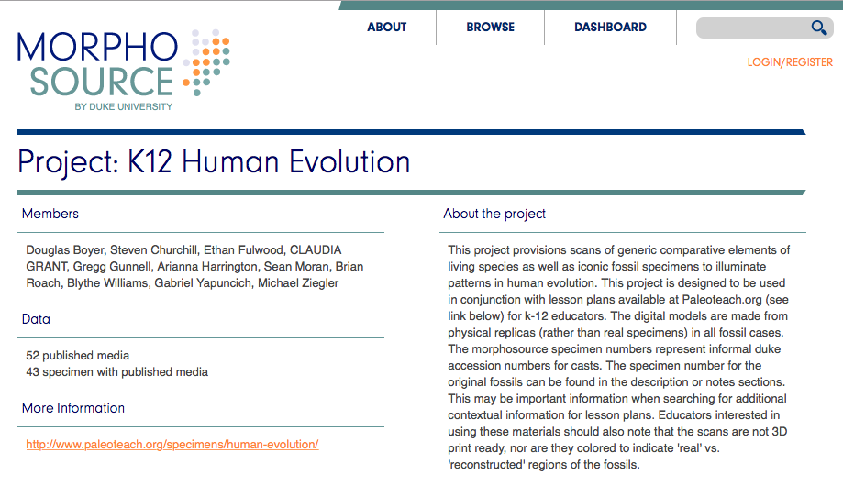
Scientific Database

Slide 14
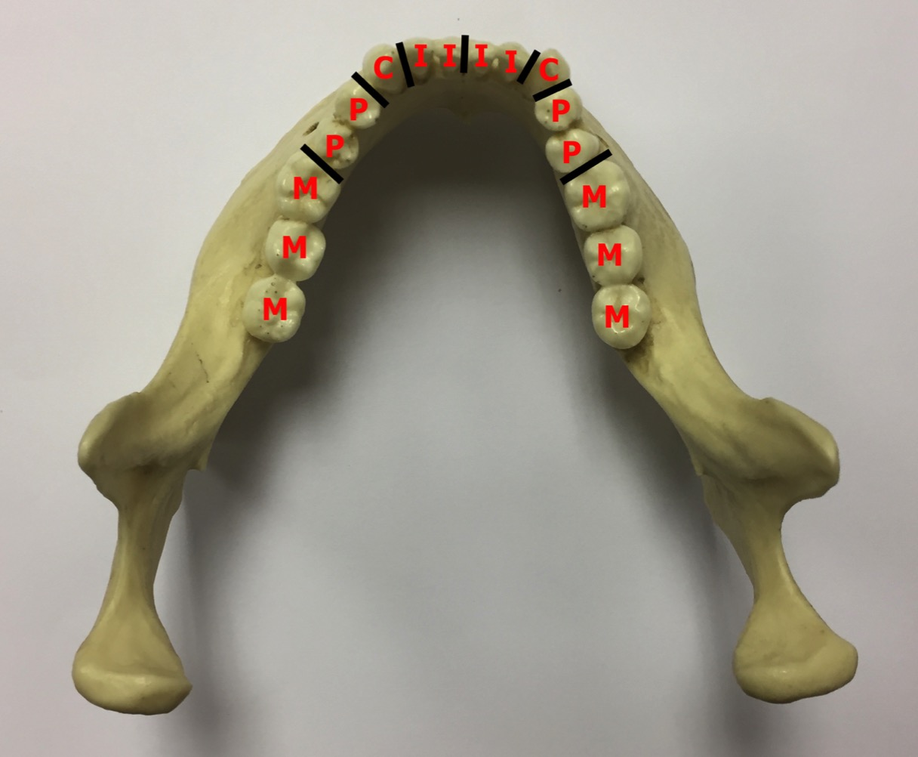

Slide 15
Tooth Types
Incisors = the flat front teeth. Incisors cut food into smaller pieces just like scissors cut paper.
Canines = teeth that tear food apart. They are next to the incisors.
Premolars = the larger, flatter teeth next to the canines. They help grind up the food that we eat.
Molars = the big, flat teeth with sharp ridges found all the way in the back of the mouth. They are perfect for crushing and grinding up food.

Slide 16
Buccolingual Tooth Measurements

Slide 17
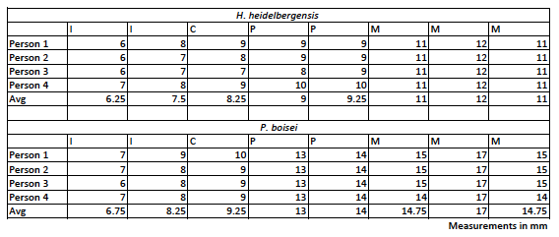
Example Averaged Measurements

Slide 18
In the beginning of this lab you learned the premolars and molars are for crushing and grinding up food. If that is the case, which of these two mandibles have molars that would be better at grinding up food? (Hint: would it be better to have big teeth if you had to grind up hard foods or would it be better to have small teeth?)

Slide 19
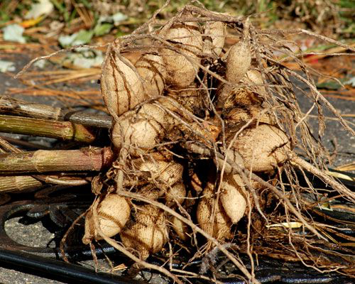
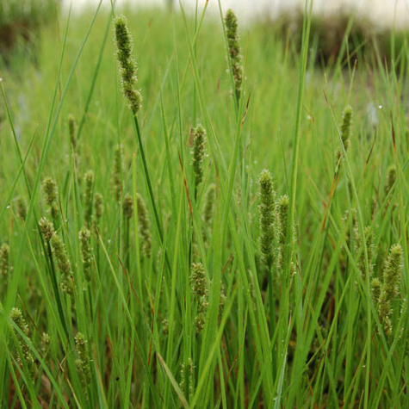
Paranthropus boisei only had access to extremely tough foods such as grasses, sedges, and tubers. They were not processing their food, and thus it was extremely tough and difficult to eat. They spent a lot time chewing their foods in order to break them down into small pieces.
Tubers
Grasses/Sedges

Slide 20
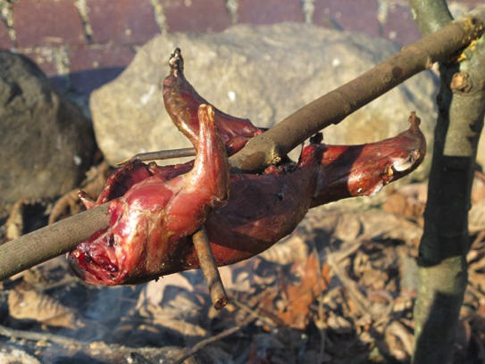
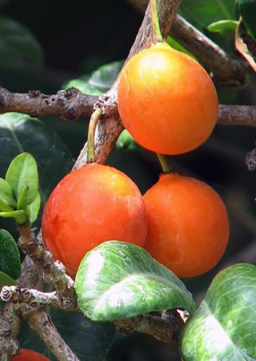
Homo heidelbergensis ate lots of plants (fruits and leaves) as well a variety of other foods (many of which we still eat today!). They were avid big-game hunters, produced sophisticated stone tools, and had control of fire (Roebroeks and Villa, 2011). All of these skills allowed them to process their foods, thus making them fairly easy to eat.
Cooked Meat
Fruit

Slide 21
Which mandible belongs to which species?

Slide 22

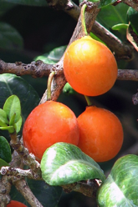

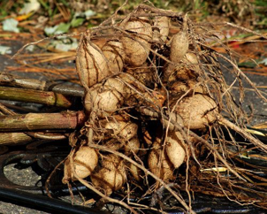
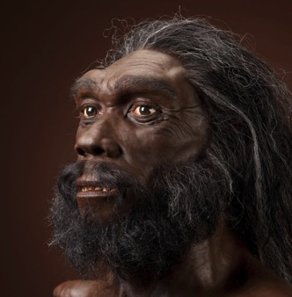
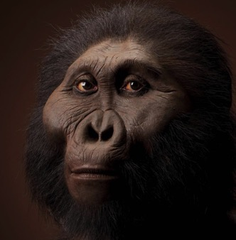

Slide 23
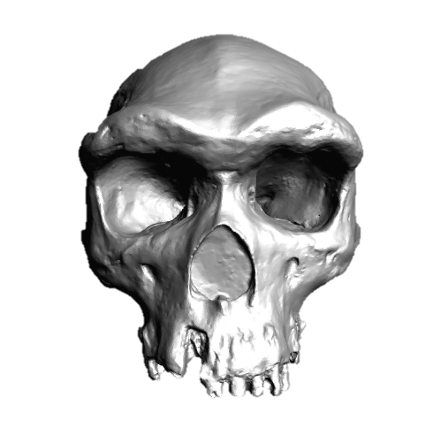
Lesson Extensions

Slide 24
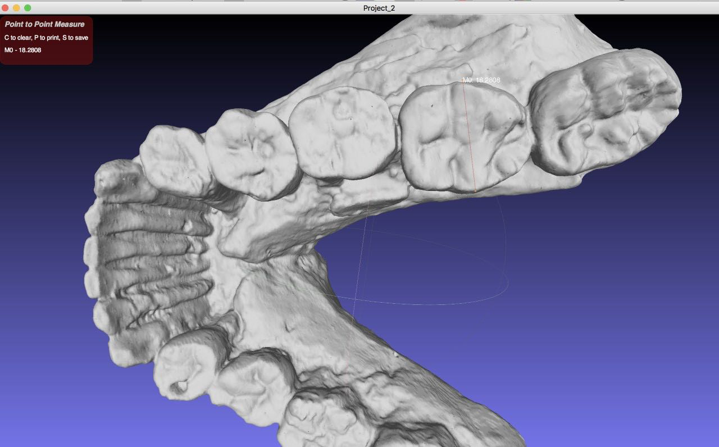

Slide 25
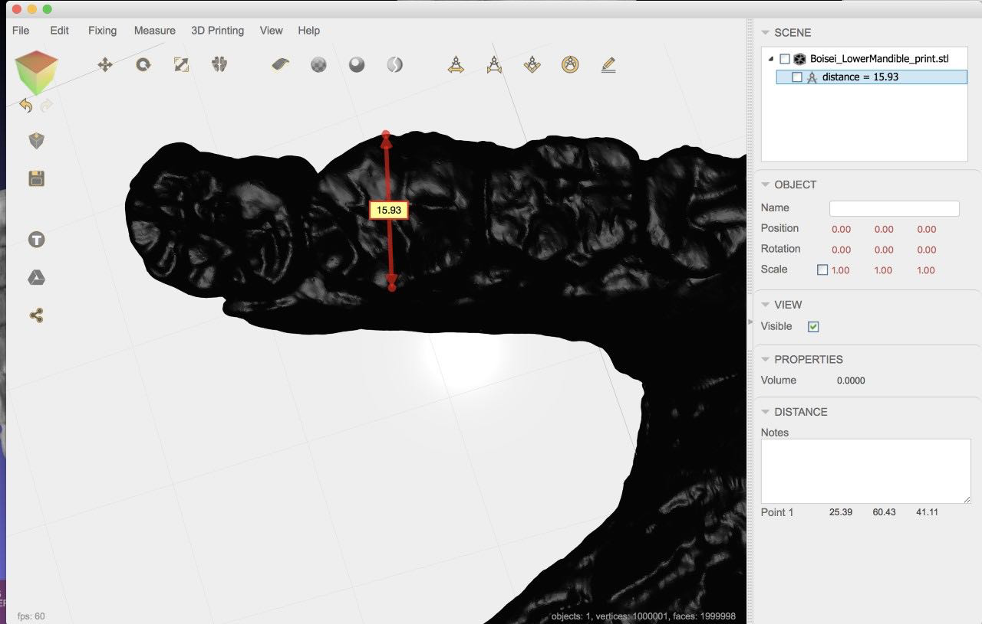

Slide 26
Other 3D Printing Resources and Opportunities

Slide 27
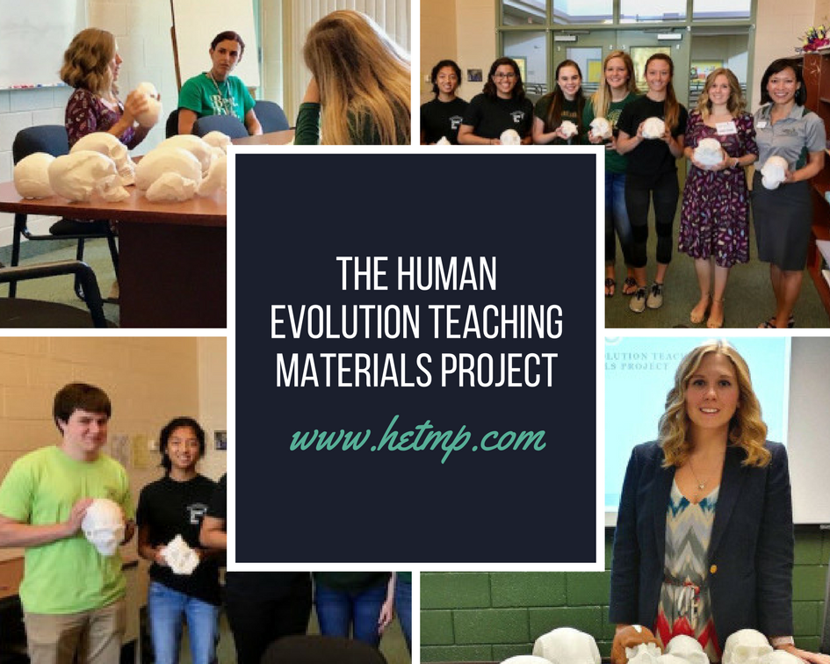

Slide 28
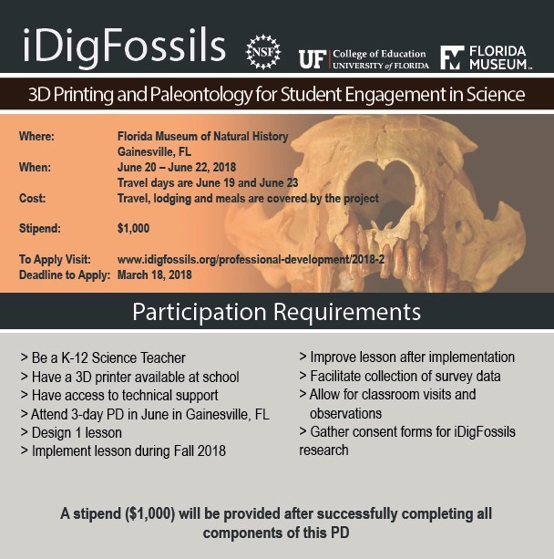

Slide 29
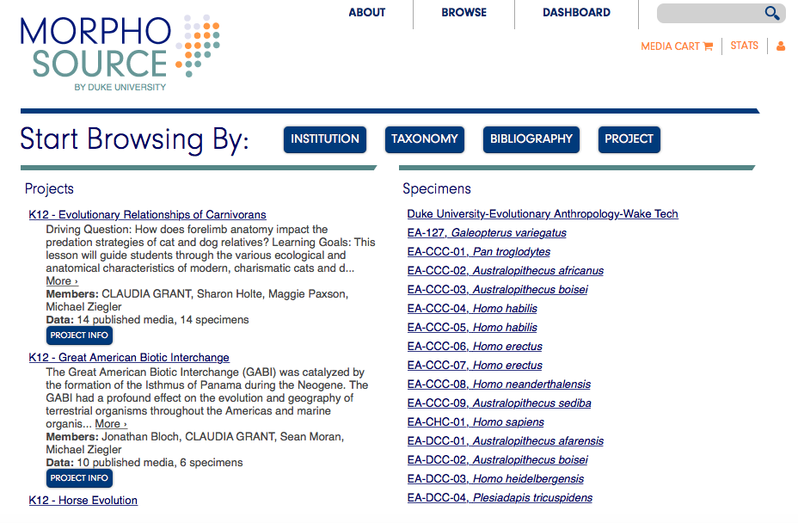

Slide 30



Thank You!
Science Educators
Scientists
National Science Foundation
Florida Museum of Natural History
University of Florida, College of Education

